Slide 1

MGT407 Principles of Human Resource Management (2020JUL27FT-2)
5 SEPT 2020
Notes:
The presentation will cover effective performance improvement strategies using recognition and rewards.

Slide 2

Recognition and reward is one of the improvement strategies used by leaders
It is used to encourage and motivate their employees/followers into performing
It is a strategy used more to motivate employees to enhance improvement
The rewards given in this strategy can be through money and promotions
Recognition is being pointed out by the seniors as a result of being a hard worker
For example, seniors can recognize a person as the employee of the month
Many human resource management use this strategy to motivate employees
Also, leaders use this strategy to motivate and gain the trust of their followers
Notes:
Recognition and reward is one of the improvement strategies that leaders use to encourage and motivate their employees/followers into performing. It is a strategy used more to motivate employees to enhance improvement in their performances. The rewards given in this strategy can be through money and promotions such as bonuses, and incentives. On the other hand, recognition is being pointed out by the seniors as a result of being a hard worker, for instance, seniors can recognize a person as the employee of the month. Leaders use this strategy to motivate and gain the trust of their followers or employees. It achieves its goal of motivation by improving the employee’s performance. Therefore, it is considered as an effective performance improvement strategy

Slide 3

Rewards and Recognition
Leaders are the ones who ensure that their employees are performing well
Engaging leaders help their employees to work on their weaknesses
Also, they encourage, manage and control the activities done by employees
Recognition and reward involves a leader who trust or is trusted by employees
When such leaders see the work well-done, they get encouraged
This leads to them motivating others by providing rewards and recognition
Rewarded and recognized employees strive to perform even better in their tasks
Also, other employees get motivated to improve their performance to get recognition and rewards
Thus, it is considered as an effective performance improvement strategy
Notes:
Leaders who engage employees in their activities are set to gain their trust. Engaging leaders help their employees to work on their weaknesses. Hence, this motivates them to work harder and smarter to achieve the set goals. However, when rewards and recognition are introduced in that built relationship, it makes the employees become more motivated and encouraged to perform well to get either the bonus being given, promotion or even recognition as one of the best employees in the company/organization. Rewarded and recognized employees strive to perform even better in their duties and work around the organization. Also, other employees get motivated to improve their performance for rewards and recognition from their seniors.

Slide 4
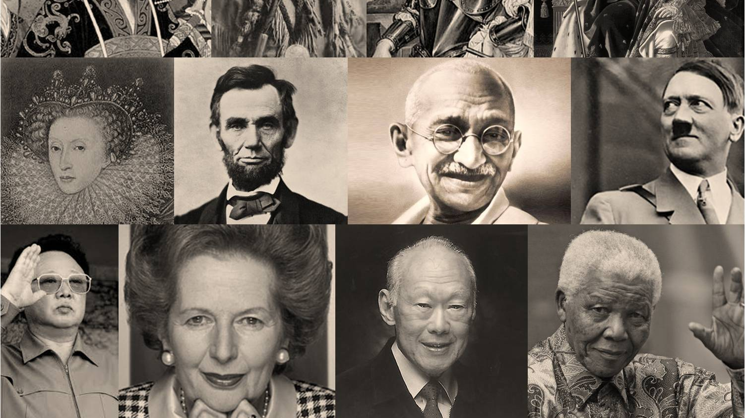
Transformational Leadership
There are certain leadership styles that are use reward and recognition strategy
First is the transformational leadership
This leadership encourages employees to act beyond exchanged relations (Barine & Mijna, 2010)
Exchanged relations include being rewarded or recognized for performing well
Leaders encourage individuals to think beyond being rewarded and recognized
Hence, it motivates their employees to expect and achieve more than rewards
This leadership helps in the promotion of intelligence, careful problem-solving and rationality
The leadership supports rewards and recognition as strategies for improvement
It achieves its goal of motivation by improving the employee’s performance
However, it motivates employees to achieve more than recognition and rewards
Notes:
Transformational leadership encourages employees to act beyond exchanged relations. Exchanged relations include being rewarded or recognized for performing well or achieving the set goals. Transformational leaders encourage individuals to think beyond being rewarded and recognized and focus more on strengths and weakness that comes along with their jobs (Barine & Mijna, 2010). Hence, it motivates their employees to expect and achieve more than rewards. However, the leadership supports rewards and recognition as strategies for improvement because most employees are encouraged in getting bonuses and promotions within the organizations. This shows that the leader is supporting their employees by any means possible. However, transformation leadership motivates employees to achieve more than recognition and rewards.

Slide 5

Transactional Leadership
The second leadership style is transactional leadership
It focuses on rewards and exchanges when expectations in performance are met
Hence, leaders control most activities and gives orders on work should be done
Also, leaders solely rely on control, punishments, and rewards (Barine & Mijna, 2010)
This is to make employees focus on the set goals
Also, if the goals are not met, punishments are put across to serve as a lesson for other individuals
They also motivate employees by setting goals for them
Once these goals are met, there are rewards and recognition for the employees
Therefore, reward and recognition strategy is used as a way of achieving set goals
Notes:
Transactional leadership focuses on rewards and exchanges when expectations in performance are met such as performance improvement in a certain sector. Hence, leaders control most activities and gives orders on how and when work should be done. They set objectives and goals which they expect employees to reach for them to get the rewards and recognition. Transactional leadership solely rely on control, punishments, and rewards to make employees focus on the set goals (Barine & Mijna, 2010). Once these goals are met, there are rewards and recognition for the employees. Therefore, reward and recognition strategy is used by this leadership as a way of achieving set goals and improving performance within the organization.

Slide 6
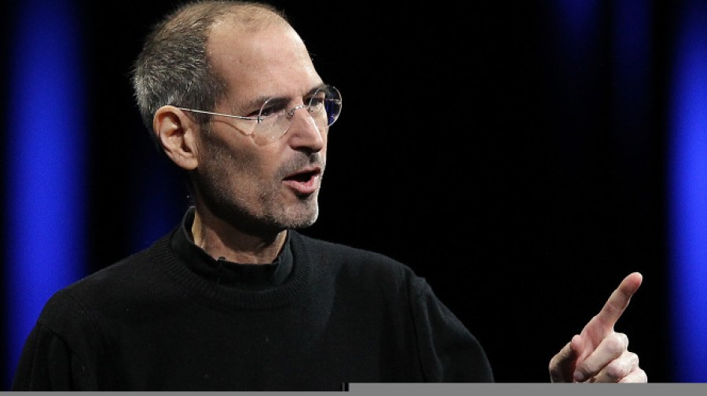
Charismatic Leadership
The third leadership style is charismatic leadership
Charismatic leaders are said to produce employees who perform exceedingly well (Luthans, 2011)
Even if there are rewards and recognition, employees exceed their expectations
Therefore, charismatic leaders supports, develops and coaches their employees
They align their vision with the aspirations and needs of their employees (Paschen & Dihsmaier, 2014)
It relies on internal moral standards that leads to satisfaction of societal and organizational interests
For that reason, rewards and recognition is one of the motivating strategies for improvement
This leadership does not rely on rewards and recognition improved performance
But rewards and recognition acts as a motivator to achieving certain goals
Notes:
Charismatic leadership or charismatic leaders are said to produce employees who perform exceedingly well (Luthans, 2011). They are self-aware and determined to achieve the goals which they have set for themselves. Even if there are rewards and recognition, employees exceed their expectations because their main goal is to produce high-level performance. Hence, for this to happen, charismatic leaders support, develop and coach their employees on how to use different strategies to increase their performance. They also align their vision with the aspirations and needs of their employees by incorporating rewards and recognition which is one of the motivating strategies for performance improvement (Paschen & Dihsmaier, 2014). However, this leadership does not rely on rewards and recognition for individuals to achieve their goals but acts as a motivator to achieving them.

Slide 7

Conclusion
Rewards and recognition is used to enhance effective performance improvement
However, some leadership styles fully rely on it to achieve their set goals
Whereas, certain leadership styles use it only as a motivating factor
This means that, they do not rely on it fully to improve on performance
Even so, rewards and recognition is known to motivate individuals effectively
Many employees strive to perform well to receive rewards or recognition
It is considered as an effective performance improvement strategy;
Since the goal of motivation by improving the employee’s performance is met
Therefore, all effective strategies of performance improvement incorporate rewards and recognition
Notes:
Rewards and recognition is used to enhance effective performance improvement. However, some leadership styles fully rely on it to achieve their set goals while, certain leadership styles use it only as a motivating factor. This means that, they do not rely on it fully to improve on performance. Even so, rewards and recognition is known to motivate individuals effectively in working on their goals in effective ways as shown by their leaders in the case of charismatic leadership. Many employees strive to perform well to receive rewards or recognition; hence, it is considered as an effective performance improvement strategy; since the goal of motivation by improving the employee’s performance is met. It is considered as an effective performance improvement strategy; Since the goal of motivation by improving the employee’s performance is met

Slide 8
References
Barine, K. A., & Minja, D. (2010). Transformational corporate leadership. Integrity Publishers Incorporated.
Luthans, F. (2011). Organizational Behavior: An Evidence Based Approach, 13th Ed. Trident Online Library.
Paschen, M., & Dihsmaier, E. (2014). Leadership, Personality, and Charisma: How to Generate Leadership Strength Through Confidence and Trust. In The Psychology of Human Leadership (pp. 27-60). Springer, Berlin, Heidelberg.

